Slide 1
The Network Layer in the Internet IP and IPv6

Slide 2
The Network Layer in the Internet
The IP Version 4 Protocol
IP Addresses
IP Version 6
Internet Control Protocols
Label Switching and MPLS
OSPF—An Interior Gateway Routing Protocol
BGP—The Exterior Gateway Routing Protocol
Internet Multicasting
Mobile IP

Slide 3
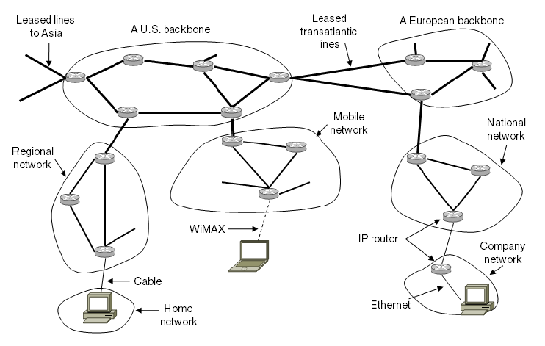
The Network Layer in the Internet
The Internet is an interconnected collection of many networks.

Slide 4
IP – A “best effort” service
IP is very simple
IP offers a connectionless service
IP is best effort.
No error correction
No reliability guarantees
Packets do not necessarily arrive in the order at which they were sent
IP networks are datagram networks
Datagrams with the same source and destination could follow different paths

Slide 5
IP – A “best effort” service
IP receives TPDUs from layer 4,
breaks them up so they can be sent as IP datagrams,
gets them to their destination (most of the times anyway),
re-assembles the original TPDU
and delivers it to layer 4 on the receiving end

Slide 6
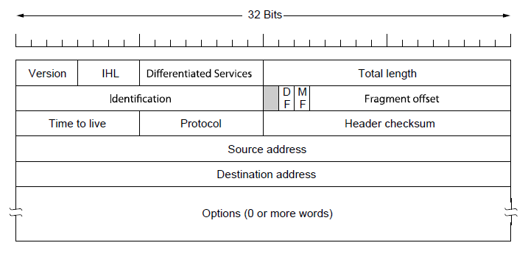
The IP Version 4 Header
IPv4 (or simply IP - Internet Protocol) header.

Slide 7
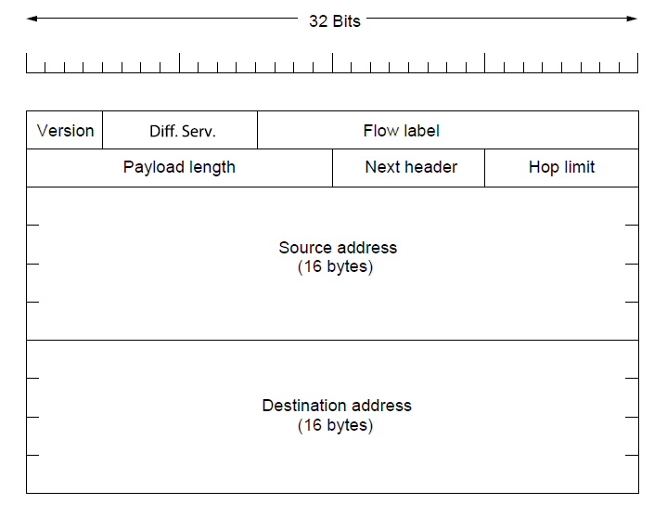
IPv6
The IPv6 fixed header (fixed part): Much simpler than IP.

